Slide 1
RISC Architecture
Wesley Fegan

Slide 2
What is RISC?
Short for “Reduced Instruction Set Computer”.
Designed by IBM in 1974.
Can be faster than CISC CPUs like x86.
Used in SPARC, ARM, PowerPC.
Powers smartphones, SGI, SUN, old Macs, and even Mars rovers!

Slide 3
RISC is better than CISC.
RISC instructions can take less clock cycles.
RISC was designed for efficient pipelining.
RISC processors can be very cheap.
RISC can outperform equivalent speed CISC processors.

Slide 4
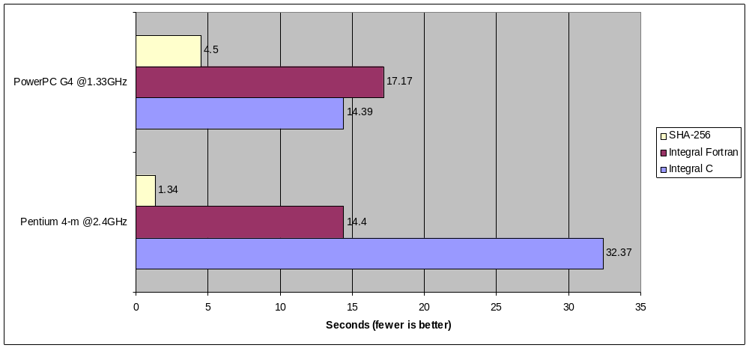
The Benchmark

Slide 5
Always RISC?
The new M1 (RISC) Macs lack support for virtualization and other software.
Windows has, almost always, been x86 exclusive.
RISC has mostly been relegated to legacy and embedded platforms.
RISC lacks many useful instructions.
RISC is not standardized, the market is heavily fragmented.

Slide 6
RISC is for Special Use Cases
RISC is great for embedded and energy efficient systems.
  Raspberry Pi
  “Smart” COVID and pregnancy tests.
32-bit ARM processors running at hundreds of MHz can cost just a few dollars.
RISC has had bad luck in the desktop/server market, but that could change.

Slide 7
Conclusion
RISC has a lot to offer and the technology is always improving.
RISC is making a comeback.
You should give RISC a try today!

Slide 8
Works Cited
“Intel Architecture Software Developer’s Manual Volume 2: Instruction Set Reference.” Intel Corporation, 1997.
“MPC7410/MPC7400 RISC Microprocessor Reference Manual.” Freescale Semiconductor, 2008.
“Pentium Processor Family Developer’s Manual Volume 3: Architecture and Programming Manual.” Intel Corporation, 1996.
Rapura, a. “Speed Tests”, https://www.math.purdue.edu/~arapura/timing.html.
“RISC Architecture.” IBM, https://www.ibm.com/ibm/history/ibm100/us/en/icons/risc/. Accessed 20 Feb. 2022.
Weaver, David. Germond, Tom. “The SPARC Architecture Manual Version 9.”, SPARC International, Inc., Prentice Hall, 2000.

